Slide 1
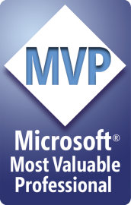
Refactoring to a SOLID Foundation
Steve Bohlen
Senior Software Engineer
SpringSource/VMware
E-Mail: sbohlen@gmail.com
Blog: http://blog.unhandled-exceptions.com
Twitter: @sbohlen

Slide 2
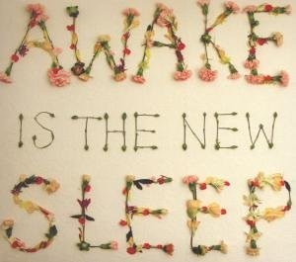
Sleep is for Wimps!

Slide 3

Indulge Yourself!

Slide 4

Get your LEARN on!

Slide 5
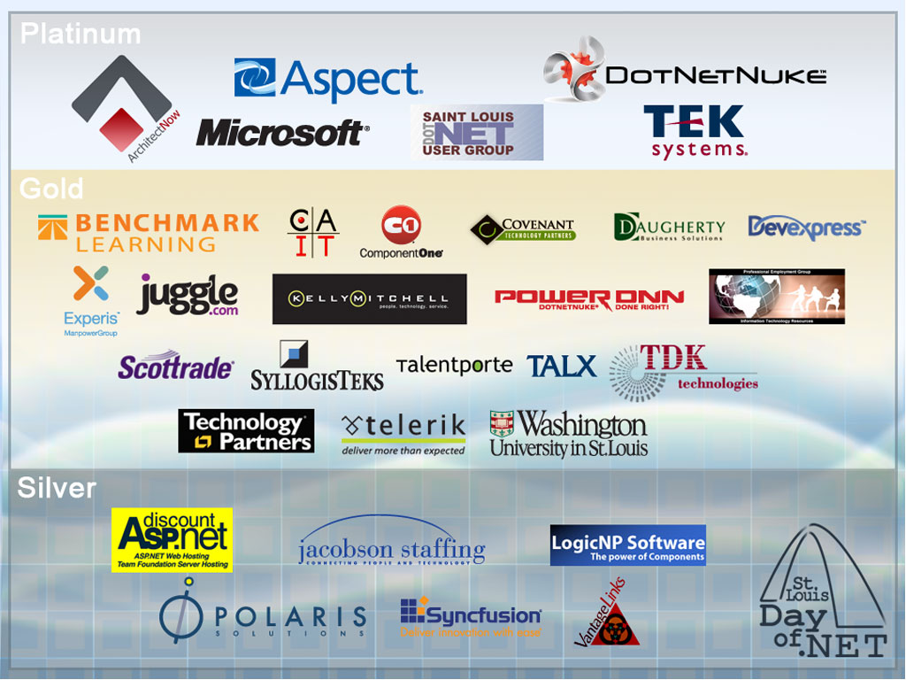

Slide 6
Do I suck?
Let me (and the world) know!
http://spkr8.com/t/8095

Slide 7
Who am I?
…and why should you care?
Steve Bohlen
I Read Books + Write Software
  vs. “Read Software + Write Books” ☺
Blog, Screencast, Speak, Share, Learn

Slide 8


Steve Bohlen
Nearly 20 years developing software
LISP, Delphi, C/C++, VB, VB.NET, C#
Senior Engineer Springsource/VMware
Co-Founder, NYC Alt.Net User Group
http://nyalt.net
Co-Organizer, NYC DDD User Group
http://dddnyc.org
Contributor: various OSS projects
NHibernate http://www.nhforge.org
NDbUnit http://www.googlecode.com/ndbunit
Spring.NET http://www.springframework.net
blog: http://blog.unhandled-exceptions.com
e-mail: sbohlen@gmail.com
twitter: @sbohlen

Slide 9

Test Studio Express
Telerik OpenAccess ORM
RAD Controls for ASP.NET AJAX
RAD Controls for Windows Phone
RAD Controls for WPF
ASPX to Razor Converter
Telerik TeamPulse
Sitefinity CMS
C#/VB.NET Converter
Telerik JustDecompile
Telerik Reporting
Telerik JustMock
RAD Controls for Winforms
RAD Controls for Silverlight
Telerik JustCode
Telerik Extensions for ASP.NET MVC
Telerik Test Studio

Slide 10


Slide 11


Slide 12
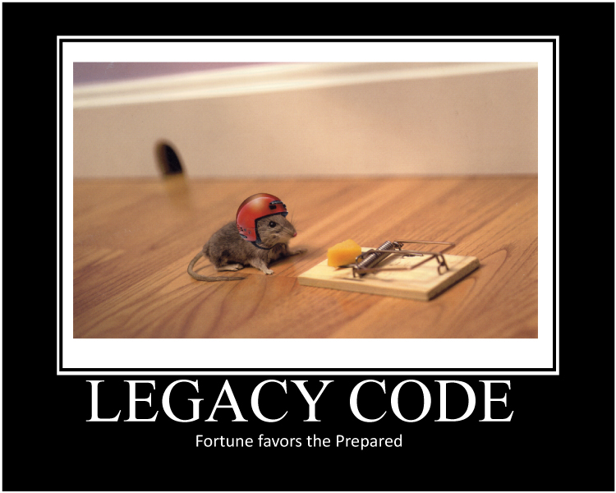

Slide 13


Slide 14
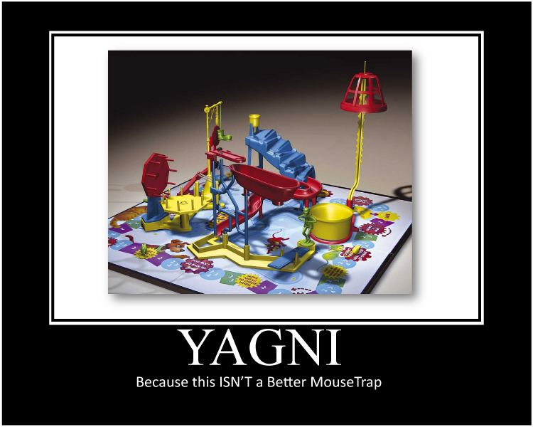

Slide 15
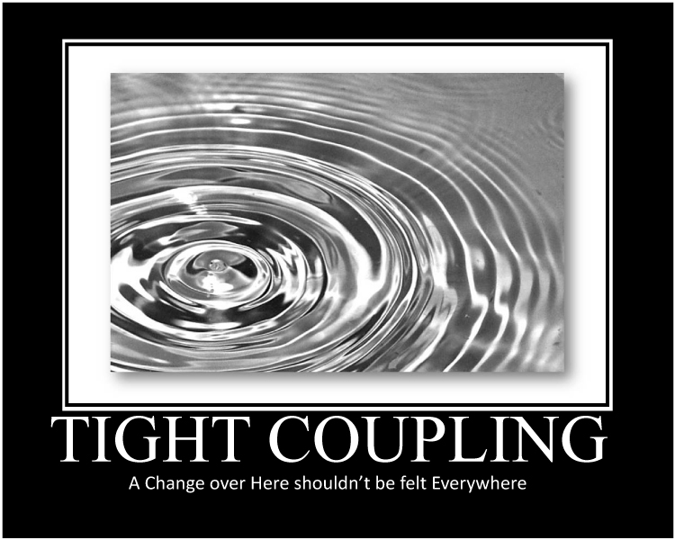

Slide 16
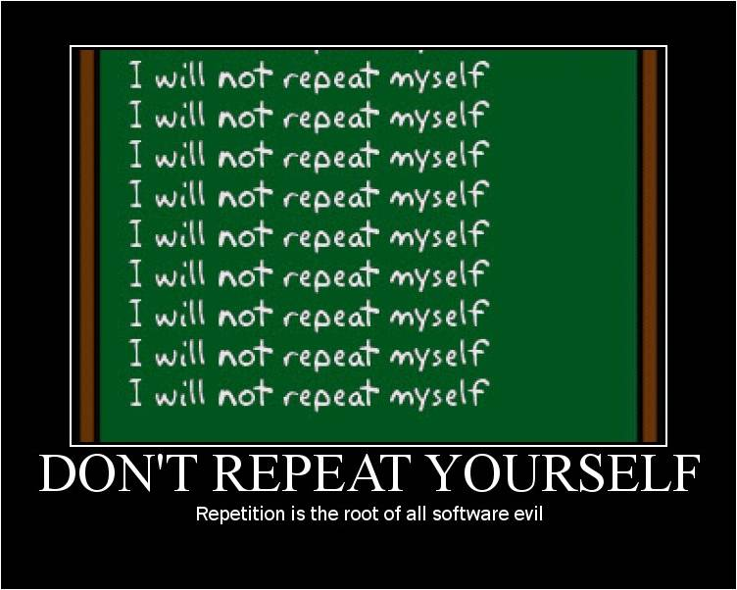

Slide 17
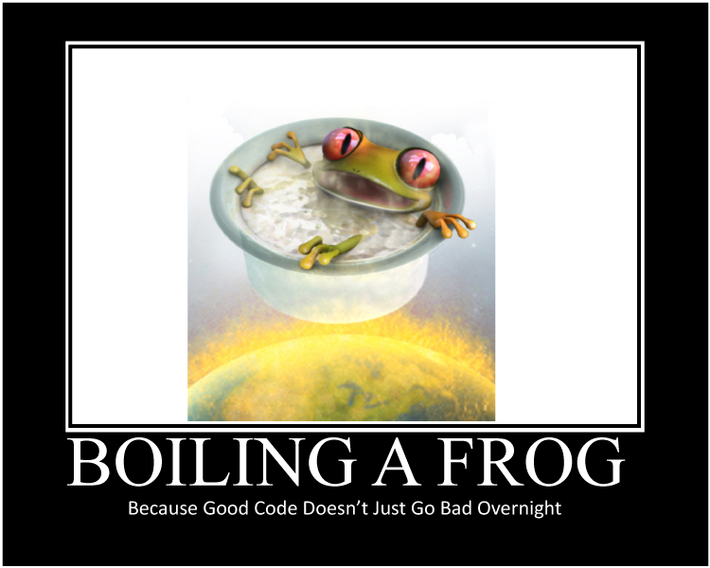

Slide 18
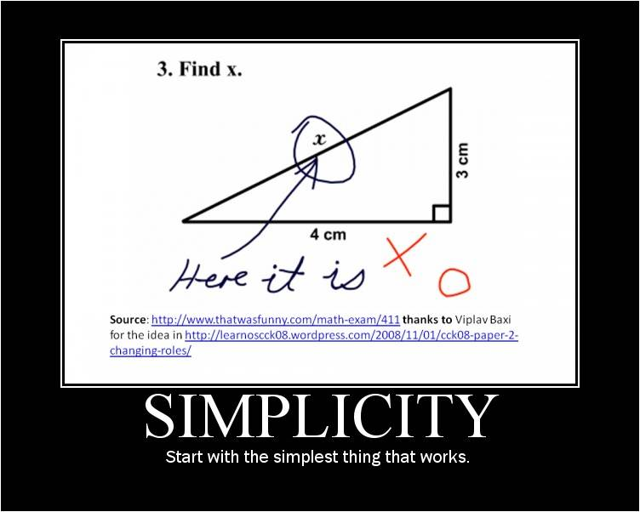

Slide 19
Refactoring
Disciplined technique
Restructuring an existing body of code
Altering its internal structure without changing its external behavior
A series of small behavior-preserving transformations
Each 'refactoring’ does little by itself
A sequence of transformations can produce a significant restructuring
Each refactoring is small so it's less likely to go wrong
The system is kept fully working after each small refactoring
Notes:
Refactoring is a disciplined technique for restructuring an existing body of code, altering its internal structure without changing its external behavior. Its heart is a series of small behavior preserving transformations. Each transformation (called a 'refactoring') does little, but a sequence of transformations can produce a significant restructuring. Since each refactoring is small, it's less likely to go wrong. The system is also kept fully working after each small refactoring, reducing the chances that a system can get seriously broken during the restructuring.

Slide 20


Slide 21
Refactoring Tools
Developer Express CodeRush
  http://devexpress.com/coderush
JetBrains Resharper
  http://www.jetbrains.com/resharper/
Telerik JustCode
  http://www.telerik.com/products/justcode.aspx
Visual Studio Professional
Notepad!

Slide 22
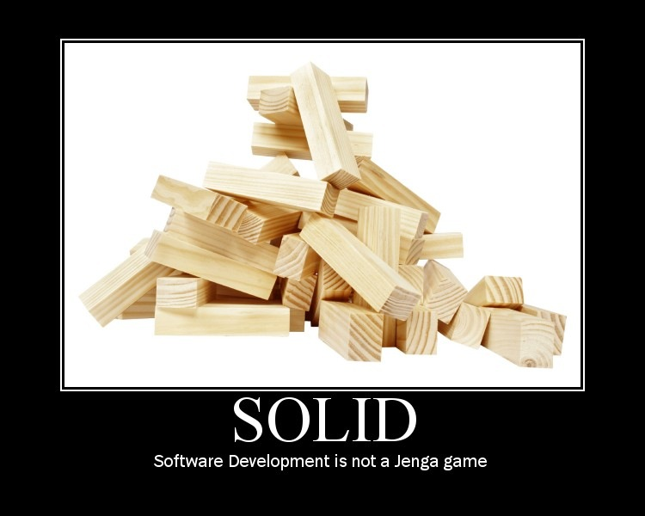

Slide 23
Introduction to S.O.L.I.D.
S
O
L
I
D
RP
ingle Responsibility Principle
CP
pen-Close Principle
SP
iskov Substitution Principle
SP
nterface Segregation Principle
IP
ependency Inversion Principle

Slide 24
Introduction to S.O.L.I.D.
S
O
L
I
D
ingle Responsibility Principle
pen-Close Principle
iskov Substitution Principle
nterface Segregation Principle
ependency Inversion Principle

Slide 25
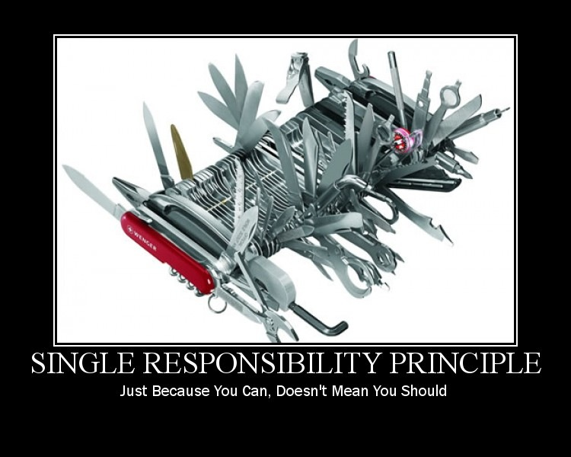

Slide 26
Single Responsibility Principle
There should never be more than one reason for a class to change.

Slide 27
Refactoring to a S.O.L.I.D. Foundation
SRP Demo

Slide 28
Introduction to S.O.L.I.D.
S
O
L
I
D
ingle Responsibility Principle
pen-Close Principle
iskov Substitution Principle
nterface Segregation Principle
ependency Inversion Principle

Slide 29
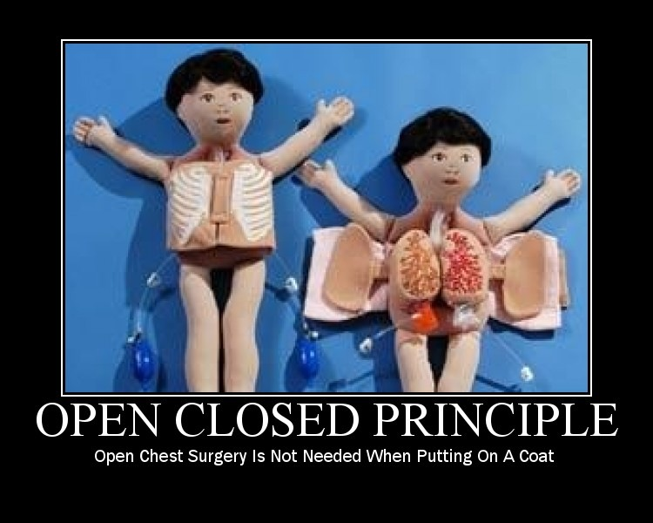

Slide 30
Open-Closed Principle
Software Entities (Classes, Modules, Functions, etc.)should be Open for Extension, but Closed for Modification.

Slide 31
Refactoring to a S.O.L.I.D. Foundation
OCP Demo

Slide 32
Introduction to S.O.L.I.D.
S
O
L
I
D
ingle Responsibility Principle
pen-Close Principle
iskov Substitution Principle
nterface Segregation Principle
ependency Inversion Principle

Slide 33
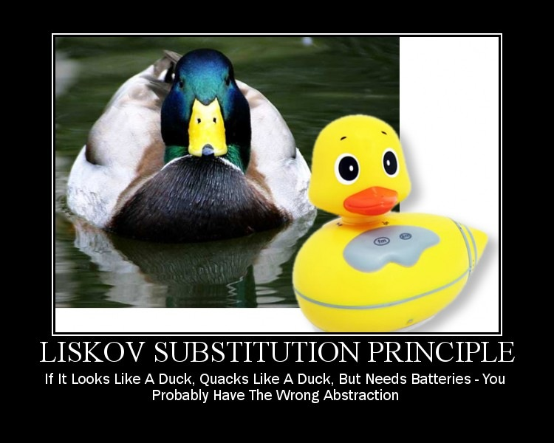

Slide 34
Liskov Substitution Principle
If for each object o₁ of type S
there is an object o₂ of type T such that
for all programs P defined in terms of T,
the behavior of P is unchanged when o₁ is substituted for o_{2,} then S is a subtype of T.
WTF ?!?

Slide 35
Liskov Substitution Principle
Functions that use pointers or references to base classes must be able to use objects of derived classes without knowing it.

Slide 36
Refactoring to a S.O.L.I.D. Foundation
LSP Demo

Slide 37
Introduction to S.O.L.I.D.
S
O
L
I
D
ingle Responsibility Principle
pen-Close Principle
iskov Substitution Principle
nterface Segregation Principle
ependency Inversion Principle

Slide 38
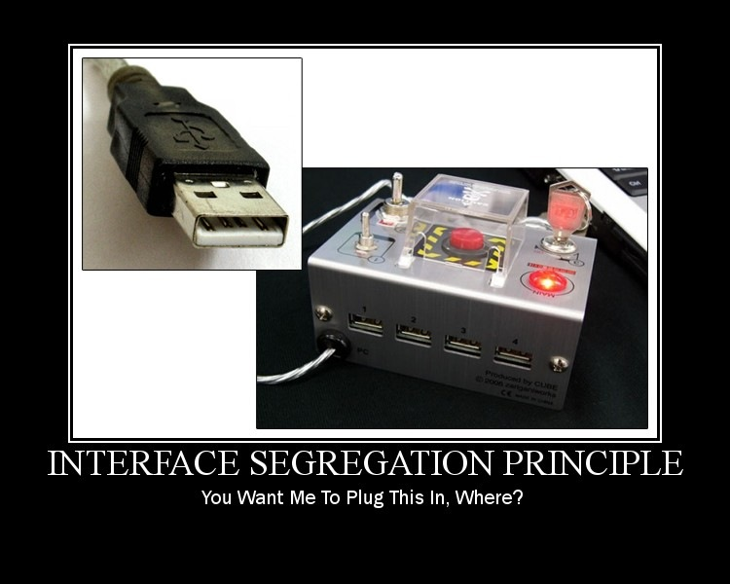

Slide 39
Interface Segregation Principle
Clients should not be forced to depend upon interfaces that they do not use.

Slide 40
Refactoring to a S.O.L.I.D. Foundation
ISP Demo

Slide 41
Introduction to S.O.L.I.D.
S
O
L
I
D
ingle Responsibility Principle
pen-Close Principle
iskov Substitution Principle
nterface Segregation Principle
ependency Inversion Principle

Slide 42
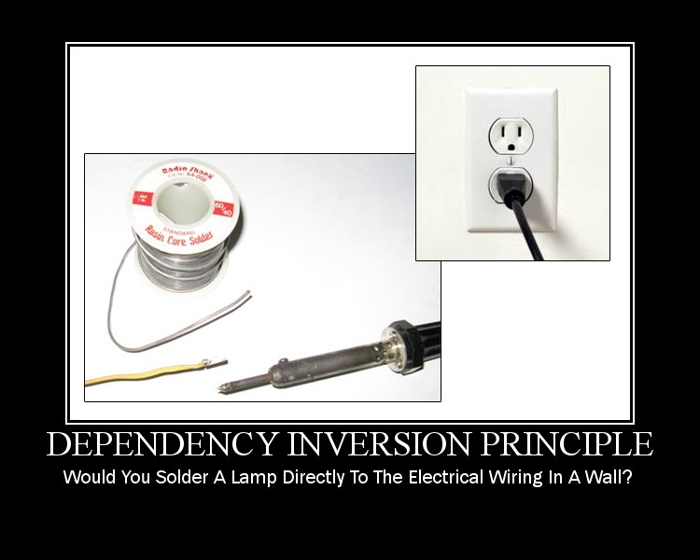

Slide 43
Dependency Inversion Principle
High Level Modules should not depend
upon Low Level Modules. Both should
depend upon abstractions.
Abstractions should not depend upon details. Details should depend upon abstractions.

Slide 44
Refactoring to a S.O.L.I.D. Foundation
DIP Demo

Slide 45
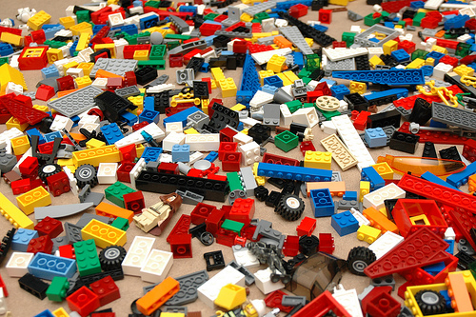
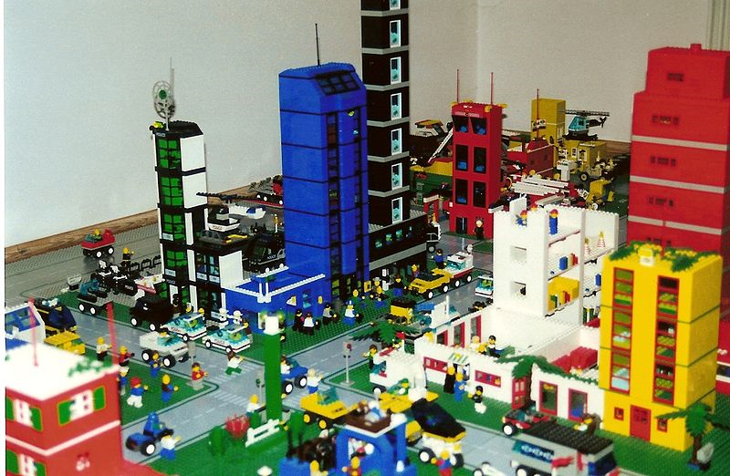
Thinking About Re-Assembly
Presto!

Slide 46
Dependency Injection Frameworks
StructureMap
Spring.NET
Castle Windsor
NInject
Funq
Unity
More…

Slide 47
Refactoring to a S.O.L.I.D. Foundation
Closing Thoughts

Slide 48
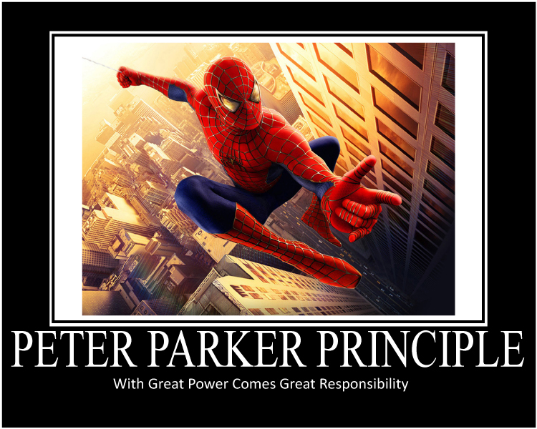

Slide 49
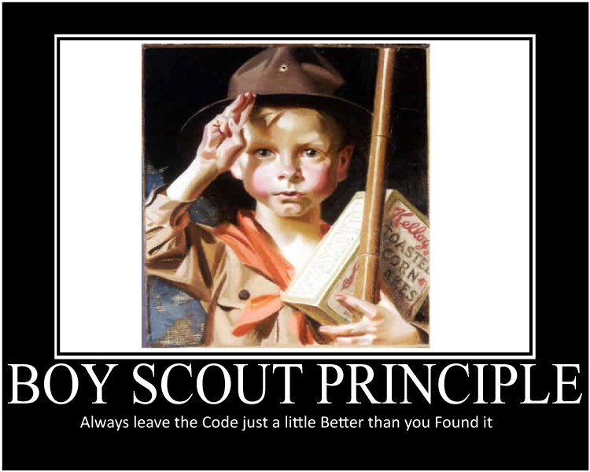

Slide 50
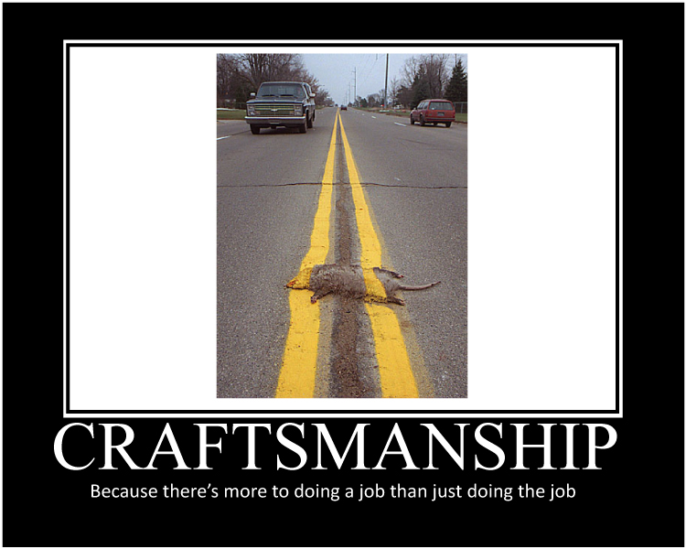

Slide 51
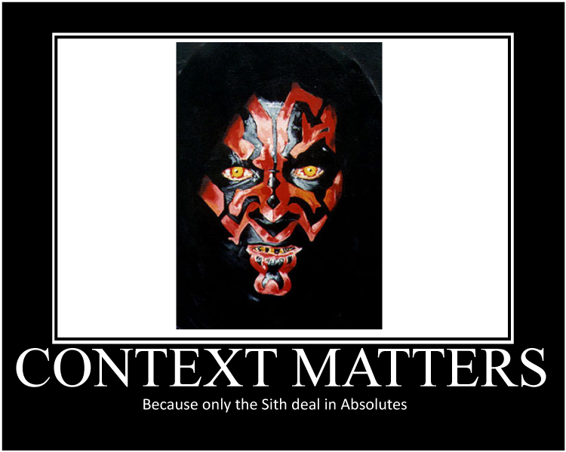

Slide 52
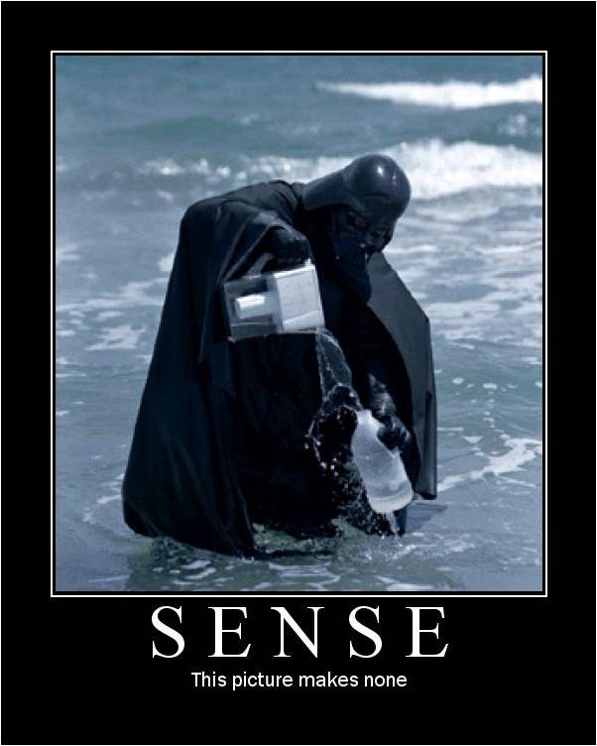

Slide 53
fini
http://spkr8.com/t/8095
Steve Bohlen
Senior Software Engineer
SpringSource/VMware
E-Mail: sbohlen@gmail.com
Blog: http://blog.unhandled-exceptions.com
Twitter: @sbohlen

