Slide 1



Taming Dependency Chaos with Inversion of Control Containers
Steve Bohlen
Senior Software Engineer
SpringSource/VMware
E-Mail: sbohlen@gmail.com
Blog: http://blog.unhandled-exceptions.com
Twitter: @sbohlen

Slide 2
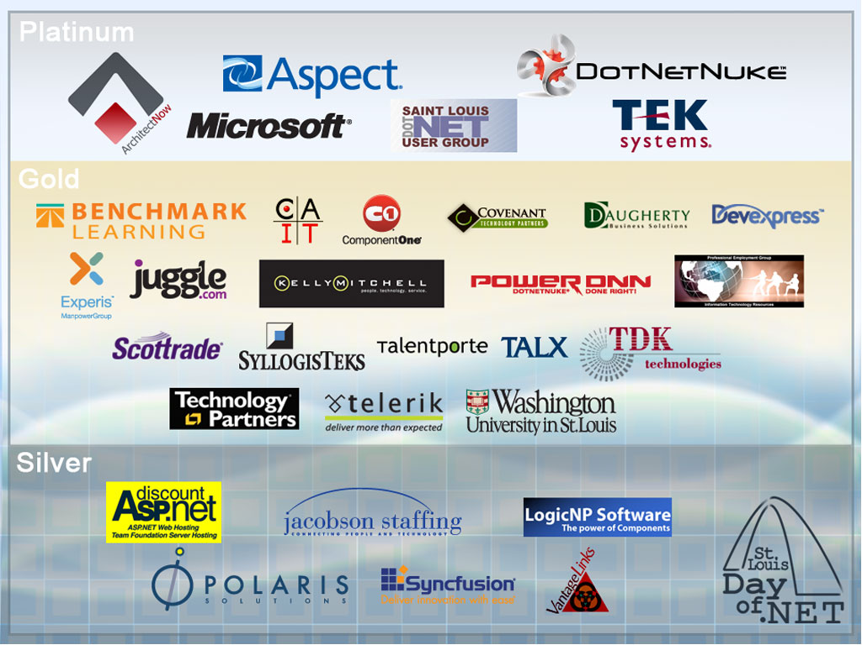

Slide 3
Do I suck?
Let me (and the world) know!
http://spkr8.com/t/8097

Slide 4
Who am I?
…and why should you care?
Steve Bohlen
I Read Books + Write Software
  vs. “Read Software + Write Books” ☺
Blog, Screencast, Speak, Share, Learn

Slide 5


Steve Bohlen
Nearly 20 years developing software
LISP, Delphi, C/C++, VB, VB.NET, C#
Senior Engineer Springsource/VMware
Co-Founder, NYC Alt.Net User Group
http://nyalt.net
Co-Organizer, NYC DDD User Group
http://dddnyc.org
Contributor: various OSS projects
Nhibernate http://www.nhforge.org
NDbUnit http://www.googlecode.com/ndbunit
Spring.NET http://www.springframework.net
blog: http://blog.unhandled-exceptions.com
e-mail: sbohlen@gmail.com
twitter: @sbohlen

Slide 6

Test Studio Express
Telerik OpenAccess ORM
RAD Controls for ASP.NET AJAX
RAD Controls for Windows Phone
ASPX to Razor Converter
RAD Controls for WPF
Telerik TeamPulse
Sitefinity CMS
C#/VB.NET Converter
Telerik JustDecompile
Telerik Reporting
Telerik JustMock
RAD Controls for Winforms
RAD Controls for Silverlight
Telerik JustCode
Telerik Extensions for ASP.NET MVC
Telerik Test Studio

Slide 7


Slide 8
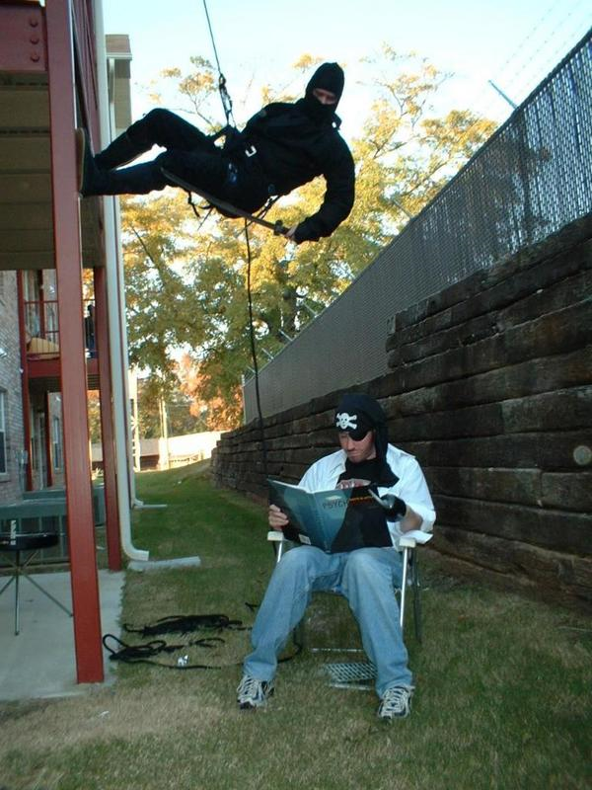

Slide 9


Slide 10
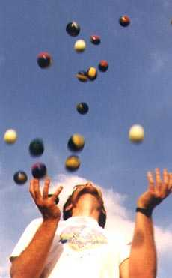


How much can you keep in your Head?

Slide 11
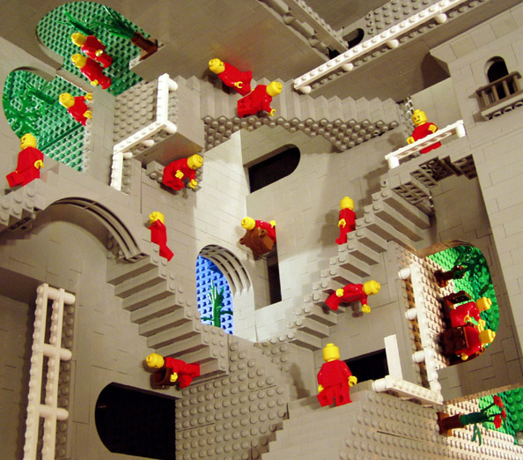
Our Application (or class, or method, etc.)

Slide 12
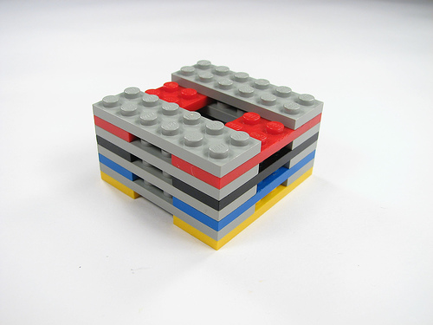
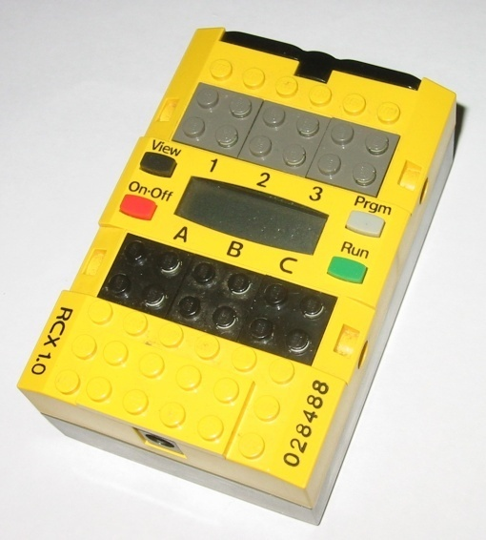
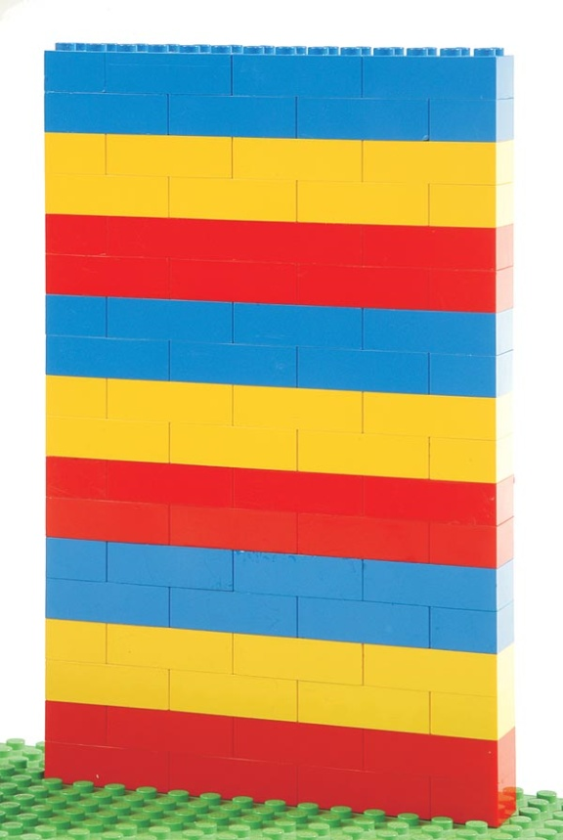
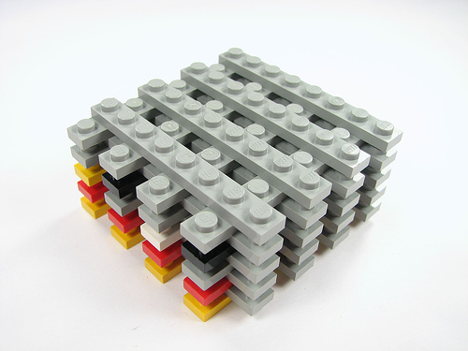
First Attempt at Decomposition
Components!

Slide 13

Ideal Decomposition Level
Units!

Slide 14

The Challenge:
Turning this into something useful
Decomposition carries overhead…
…of re-composition for meaningful work!

Slide 15
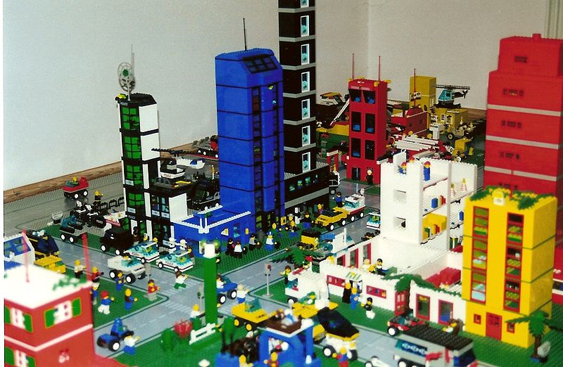
The Goal:
Units Assembled into Something Useful…
…easily!

Slide 16
Code Demo: Refactoring for Decomposition

Slide 17
Reviewing Our Dependency Graph after Decomposition
Worker
DataAccess
ConnectionManager
Logger
Logger
Logger
DataSorter
Logger
DataPrinter
Logger

Slide 18
Code Demo: Refactoring to Ease (Re-)Composition

Slide 19
Reviewing Our Dependency Graph after IoC
Worker
Construction Dependency Graph
DataAccess
Container
ConnectionManager
DataSorter
Functional Dependencies Remain as Before
DataPrinter
Logger

Slide 20
Aspect-Oriented Programming (AOP)

Slide 21
(one of) The Challenges of
OO Software Design
Not all common behaviors can be efficiently modeled by OO paradigms
  Inheritance, Dependency Injection / Inversion of Control
Simple Examples
  Logging, Authorization, Transactions, Exceptions
    …more…
We call these concerns of our application
  They are all things our objects must ‘concern’ themselves with doing
Because they cut across many objects in our application…
  …we call them cross-cutting concerns

Slide 22
Example: Logging by Inheritance
Inherit from Common Base
public abstract class LoggingBase
{
protected void Log(string msg) {…}
}
Public class Service1 : LoggingBase {…}
Awkward! ☹
Public class Service2 : LoggingBase {…}
Rigid hierarchy! ☹
Public class Service3 : LoggingBase {…}
Common Abstract Base Class
…
How do you add logging after you design your application??? ☹

Slide 23
Example: Logging by Dependency Injection
Public class Logger
{
public void Log(string msg) {…}
}
Public class Service1
{
public Service1 (Logger logger)
{
_logger = logger;
}
}
Awkward! ☹
Inject Logger Everywhere!☹
Constructor Injection
Dependency
How do you add logging after you design your application??? ☹

Slide 24
The Promise of Aspect-Oriented Programming
All (most) applications have these cross-cutting concerns
  For fun (and because it’s a common convention) let’s call them Aspects
Aspects can be applied to objects in our solution using AOP tools
  Broadly applied to many classes in our solution
  Minimally-invasive
  Non-Manual introduction of Aspects
    Not by literal coding (directly)

Slide 25
Understanding AOP Terms
Cross-Cutting Concerns
the ‘problem’ we want to solve
Advice
code that solves the problem
Pointcut
where to apply the Advice
Aspect
Pointcut + Advice = Aspect

Slide 26
Code Demo: Defining and Applying Aspects

Slide 27
Reviewing Our Dependency Graph after IoC
DoSomeWork
Construction Dependency Graph
DataAccess
Container
ConnectionManager
DataSorter
Functional Dependencies Remain as Before
DataPrinter
Logger

Slide 28
Reviewing Our Dependency Graph after AOP
DoSomeWork
Logger
DataAccess
Logger
Container
ConnectionManager
Logger
DataSorter
Logger
DataPrinter
Logger

Slide 29
Understanding the Mechanics of AOP
Advised Type
Advice
Your Code
IoC
Type with Advice Applied

Slide 30
Thinking About Re-Assembly
Presto!

Slide 31
Dependency Injection Frameworks
StructureMap
Spring.NET
Castle Windsor
NInject
Funq
Unity
More…

Slide 32
fini
http://spkr8.com/t/8097
Steve Bohlen
Senior Software Engineer
SpringSource/VMware
E-Mail: sbohlen@gmail.com
Blog: http://blog.unhandled-exceptions.com
Twitter: @sbohlen

