Slide 1


Unit Testing Patterns and Anti-Patterns
Steve Bohlen
E-Mail: sbohlen@gmail.com
Blog: http://blog.unhandled-exceptions.com
Twitter: @sbohlen

Slide 2















We want to thank the sponsors of KCDC. Without them, none of this would be possible.
Thanks to Our Sponsors
Gold Sponsors
Silver Sponsors
Product Sponsors

Slide 3
Do I suck?
Let me (and the world) know!
http://spkr8.com/t/7866

Slide 4

Steve Bohlen
Nearly 20 years developing software
LISP, Delphi, C/C++, VB, VB.NET, C#
Senior Engineer Springsource/VMware
Co-Founder, NYC Alt.Net User Group
http://nyalt.net
Co-Organizer, NYC DDD User Group
http://dddnyc.org
Contributor: various OSS projects
Nhibernate http://www.nhforge.org
NDbUnit http://www.googlecode.com/ndbunit
Spring.NET http://www.springframework.net
blog: http://blog.unhandled-exceptions.com
e-mail: sbohlen@gmail.com
twitter: @sbohlen

Slide 5

Test Studio Express
Telerik OpenAccess ORM
RAD Controls for ASP.NET AJAX
RAD Controls for Windows Phone
ASPX to Razor Converter
RAD Controls for WPF
Telerik TeamPulse
Sitefinity CMS
C#/VB.NET Converter
Telerik JustDecopile
Telerik Reporting
Telerik JustMock
RAD Controls for Winforms
RAD Controls for Silverlight
Telerik JustCode
Telerik Extensions for ASP.NET MVC
Telerik Test Studio

Slide 6


Slide 7


Slide 8
Definition: Pattern
Anti-
Anti-
In software engineering, a design pattern is a general reusable solution to a commonly occurring problem in software design.
that leads to commonly occurring problems in software design.

Slide 9
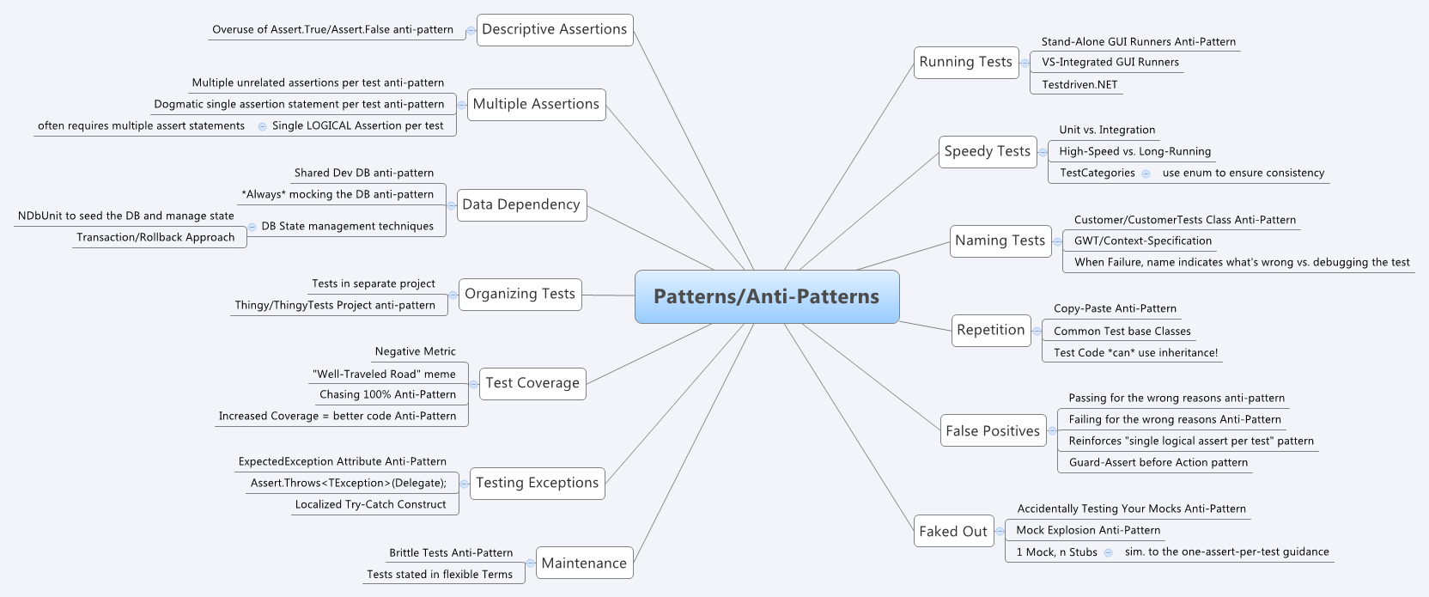

Slide 10
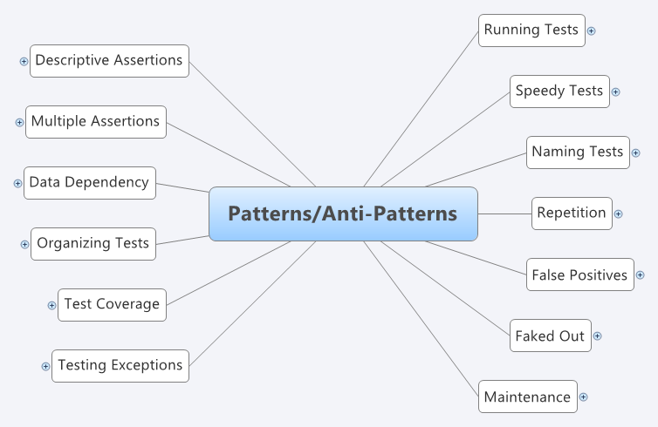

Slide 11
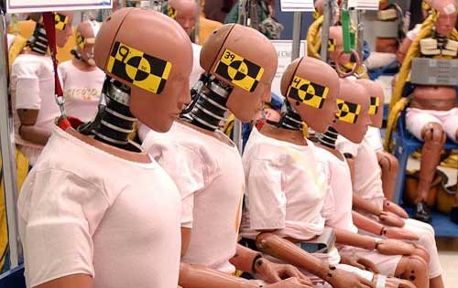
Challenge: Running Tests

Slide 12
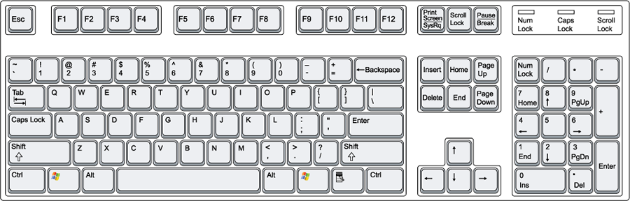
Interacting with your Tests
Rerun
Run Selected Tests
Rerun
Debug Selected Tests

Slide 13

Challenge: Speedy Tests

Slide 14
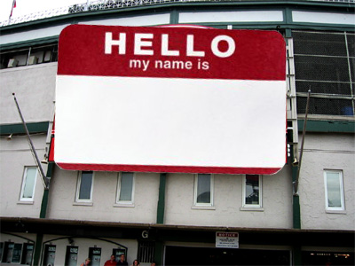
Challenge: Naming Tests

Slide 15

Challenge: Descriptive Assertions

Slide 16
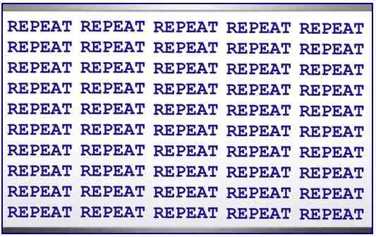
Challenge: Repetition

Slide 17

Challenge: False Positives

Slide 18

Challenge: Faked Out!

Slide 19
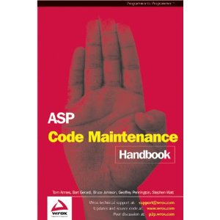
Challenge: Maintenance

Slide 20
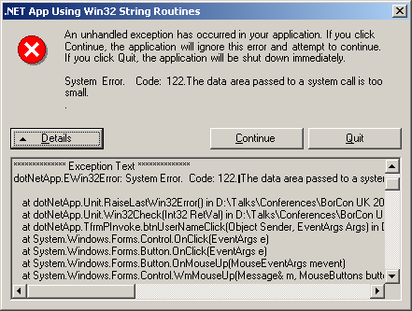
Challenge: Testing Exceptions

Slide 21
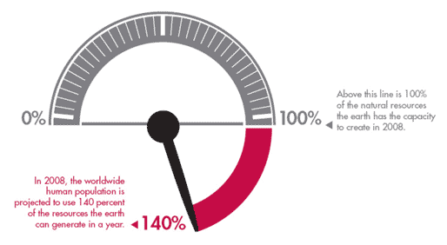
Challenge: Test Coverage

Slide 22

Challenge: Organizing Tests

Slide 23

Challenge: Data Dependency

Slide 24

Challenge: Multiple Assertions

Slide 25
And now for something completely different…
…code!

Slide 26
fini
Steve Bohlen
E-Mail: sbohlen@gmail.com
Blog: http://blog.unhandled-exceptions.com
Twitter: @sbohlen

